Slide 1

Evaluating the Re-Designed Urgent and Emergency Care Set-Up in Northumberland CCG
S. Conti
Improvement Analytics Unit
NHSE/I Analytical Academy Seminar series
14 October 2020
NHS ENGLAND
NHS IMPROVEMENT

Slide 2
NHS ENGLAND
NHS IMPROVEMENT
Context
Method
Results
Remarks
Bibliography

Slide 3
Context
NHS ENGLAND
NHS IMPROVEMENT
The Improvement Analytics Unit assessed the impact on hospital activity between August 2015 and July 2016 of the re-designing of urgent and emergency care in the Northumberland CCG^{[1]} using the Synthetic Control Method^{[2]} (SCM)
Population: | individuals registered with a Northumberland CCG GP
Intervention: | the opening in June 2015 of the Northumbria Specialist Emergency Care Hospital and gradual conversion of 3 local A&E departments into urgent, non-emergency care hubs
Comparator: | individuals registered with a GP not under the remit of Northumberland CCG
Outcomes: | A&E attendance rates non- / elective admissions rates % of A&E attendances lasting under 4hrs % of A&E attendances converting into admissions length of A&E waiting time length of hospital stay for non- / elective admissions …

Slide 4
Method
NHS ENGLAND
NHS IMPROVEMENT
Forming a control group that is as similar as practical to that in receipt of the intervention (‘treated’) is key to drawing meaningful and unbiased outcome comparison
a before vs after analysis is unable to identify / isolate drivers of outcome changes
Assume the case of a single, aggregate-level treated unit (e.g. the Northumberland CCG)
SCM weights available control units, so that the weighted average of their outcome trends (and of any baseline covariates) before the intervention closely matches that shown by the treated unit
control units with more similar characteristics to the treated one will receive higher weight
a separate ‘synthetic’ control CCG was built for each outcome from 4 year pre-intervention data
The impact of the intervention at any time after it embedded is estimated by subtracting the synthetic outcome (i.e. its weighted average across controls) from that observed from the treated unit

Slide 5
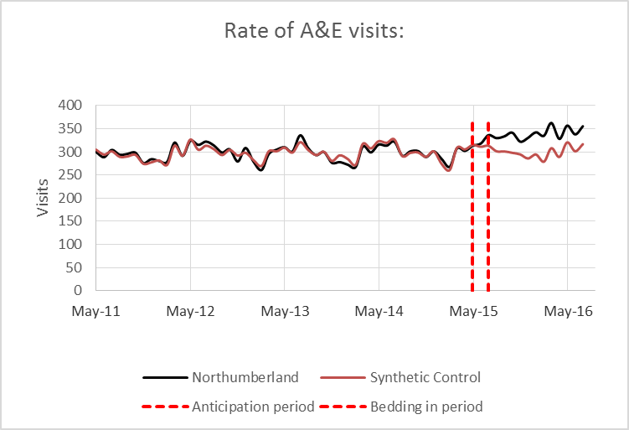
Results
NHS ENGLAND
NHS IMPROVEMENT

Slide 6
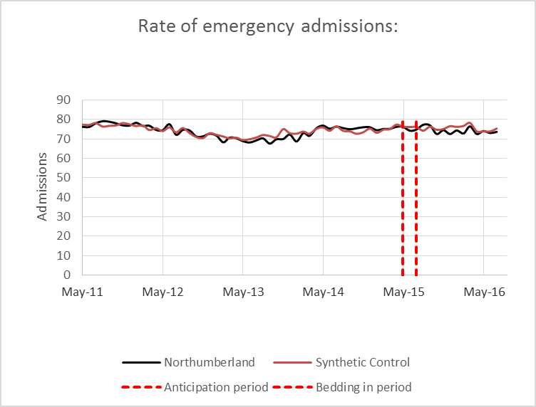
Results (cont.)
NHS ENGLAND
NHS IMPROVEMENT

Slide 7
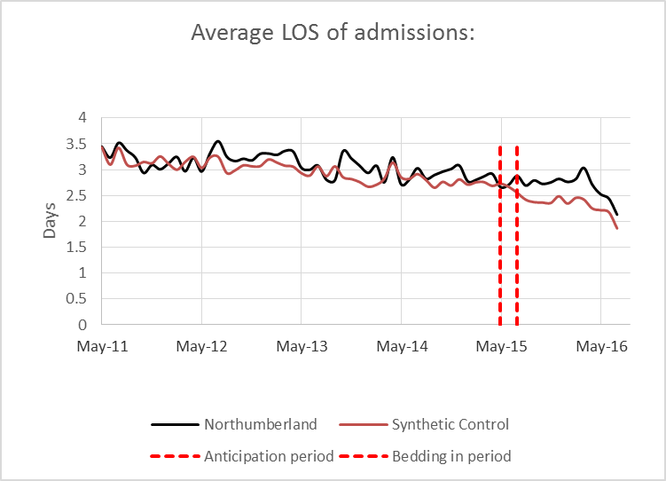
Results (cont.)
NHS ENGLAND
NHS IMPROVEMENT

Slide 8
Results (cont.)
NHS ENGLAND
NHS IMPROVEMENT
Following the intervention people under the Northumberland CCG remit, relative to those in the synthetic control CCG, saw a (plausibly) statistically significant:
13.6% increase in A&E attendance rates
10.5% reduction in average A&E waiting time
6.9% increase in the proportion of A&E attendances lasting under 4hrs
Additional details can be found in the IAU case-study documentation^{[1]}

Slide 9
Remarks
NHS ENGLAND
NHS IMPROVEMENT
SCM is well suited to geographically / administratively delimited, aggregate-level units
The accuracy of SCM can be assessed via placebo testing (if only informally)
A poor observed-to-synthetic trend match over the pre-intervention period will lead to biased SCM estimates
SCM yields more dependable results the longer the pre-intervention period and the less volatile the outcome trends
SCM is coded in widely available analytical platforms (e.g. R, Stata, …)
Recent extensions^{[3-5]} have been proposed to accommodate multiple treated units as well as multiple (serially) correlated and / or over-dispersed outcomes

Slide 10
Bibliography
NHS ENGLAND
NHS IMPROVEMENT
S. O’Neill, A. Wolters, A. Steventon (2017): The Impact of Redesigning Urgent and Emergency Care in Northumberland: Health Foundation Consideration of Findings from the Improvement Analytics Unit. URL: https://www.health.org.uk/publications/the-impact-of-redesigning-urgent-and-emergency-care-in-northumberland
A. Abadie, A. Diamond, J. Hainmueller (2010): Synthetic Control Methods for Comparative Case Studies: Estimating the Effect of California’s Tobacco Control Program. Journal of the American Statistical Association, 105(490):493-505. DOI: 10.1198/jasa.2009.ap08746
N. Kreif, R. Grieve, D. Hangartner, A. J. Turner, S. Nikolova, M. Sutton (2016): Examination of the Synthetic Control Method for Evaluating Health Policies with Multiple Treated Units. Health Economics, 25(12):1514-1528. DOI: 10.1002/hec.3258
Y. Xu (2017): Generalized Synthetic Control Method: Causal Inference with Interactive Fixed Effects Models. Political Analysis, 25(1):57-76. DOI: 10.1017/pan.2016.2
M. W. Robbins, J. Saunders, B. Kilmer (2017): A Framework for Synthetic Control Methods With High-Dimensional, Micro-Level Data: Evaluating a Neighborhood-Specific Crime Intervention. Journal of the American Statistical Association, 112(517):109-126. DOI: 10.1080/01621459.2016.1213634

Slide 11
NHS ENGLAND
NHS IMPROVEMENT

